Slide 1
Spring Boot

Slide 2
Training Agenda Day wise
Day 1– Introduction to Spring Boot
Day 2 – Working with Spring Data JPA
Day 3 & 4 – Web Development with Spring Boot
Day 5 – Spring Boot Security & Monitoring Applications

Slide 3

Spring Boot Overview
Spring Boot makes it easy to create stand-alone, production-grade Spring based Applications that you can "just run".
We take an opinionated view of the Spring platform and third-party libraries so you can get started with minimum fuss.
Most Spring Boot applications need minimal Spring configuration.

Slide 4
Features
Create stand-alone Spring applications
Embed Tomcat, Jetty or Undertow directly (no need to deploy WAR files)
Provide opinionated 'starter' dependencies to simplify your build configuration
Automatically configure Spring and 3rd party libraries whenever possible
Provide production-ready features such as metrics, health checks, and externalized configuration
Absolutely no code generation and no requirement for XML configuration

Slide 5
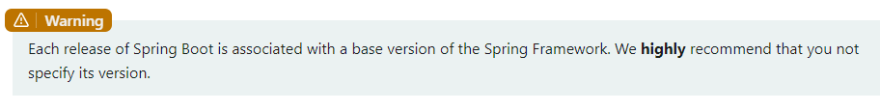
Java Baseline
Spring Boot 2.x will no longer support Java 7 and below, being Java 8 the minimum requirement.
Bill of Materials - With every new release of Spring Boot, versions of various dependencies of the Java ecosystem get upgraded. This is defined in Boot bill of materials aka BOM.

Slide 6
Dependency Management
Each release of Spring Boot provides a curated list of dependencies that it supports.
In practice, you do not need to provide a version for any of these dependencies in your build configuration, as Spring Boot manages that for you.
When you upgrade Spring Boot itself, these dependencies are upgraded as well in a consistent way.
Starters are a set of convenient dependency descriptors that you can include in your application.

Slide 7
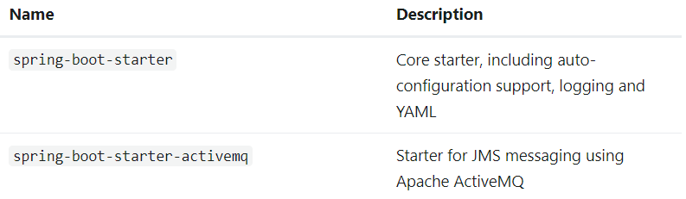
Starters
Starters are a set of convenient dependency descriptors that you can include in your application.
You get a one-stop shop for all the Spring and related technologies that you need without having to hunt through sample code and copy-paste loads of dependency descriptors.
The starters contain a lot of the dependencies that you need to get a project up and running quickly and with a consistent, supported set of managed transitive dependencies.
Link : https://docs.spring.io/spring-boot/docs/current/reference/htmlsingle/#using.build-systems.starters

Slide 8
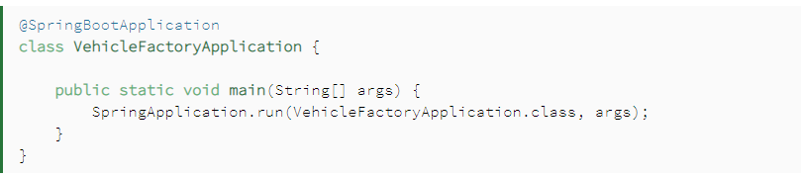
Auto Configuration
Spring Boot made configuring Spring easier with its auto-configuration feature.
We use this annotation to mark the main class of a Spring Boot application:
@SpringBootApplication encapsulates @SpringBootConfiguration,
@EnableAutoConfiguration, and @ComponentScan annotations with their default attributes.

Slide 9
Under the Covers of Spring Boot
One of Spring Boot's most powerful features is its auto-configuration.
This magic is key to the convention-over-configuration approach that has brought a huge boost in productivity to Java developers.

Slide 10
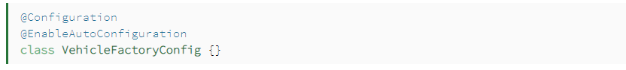
@EnableAutoConfiguration
@EnableAutoConfiguration, as its name says, enables auto-configuration.
It means that Spring Boot looks for auto-configuration beans on its classpath and automatically applies them.
Note, that we have to use this annotation with @Configuration.

Slide 11
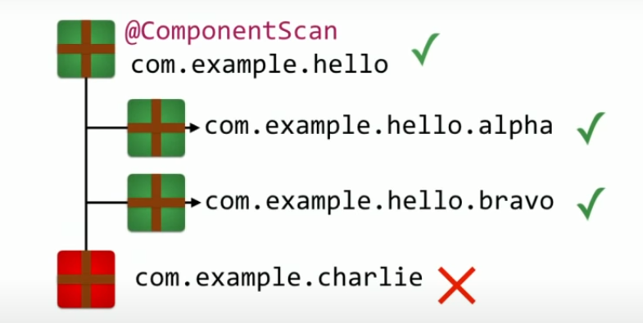
@ComponentScan
@ComponentScan: Tells Spring to look for other components/beans, configurations, and services within the particular package, letting it find the controllers.

Slide 12
@SpringBootConfiguration
Enable registration of extra beans in the context or the import of additional configuration classes.
An alternative to Spring’s standard @Configuration that aids Configuration Detection in your integrated tests.
import org.springframework.boot.SpringApplication;
import org.springframework.boot.autoconfigure.SpringBootApplication;
@SpringBootApplication // same as @SpringBootConfiguration
// @EnableAutoConfiguration @ComponentScan
public class MyApplication {
public static void main(String[] args) {
SpringApplication.run(MyApplication.class, args);
}
}

Slide 13
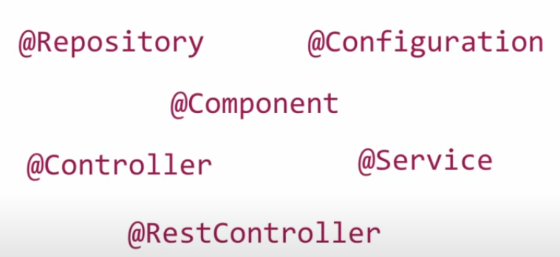
Component or Beans – Managed by Spring
All of your application components are automatically registered as Spring Beans.
@Component

Slide 14
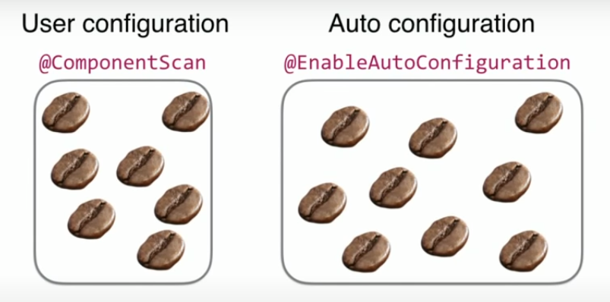
Beans Instantiation in Spring Boot Application

Slide 15
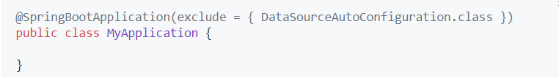
Disabling Specific Auto-configuration Classes
If you find that specific auto-configuration classes that you do not want are being applied, you can use the exclude attribute of @SpringBootApplication to disable them, as shown in the following example:

Slide 16
CommandLineRunner
CommandLineRunner is a simple Spring Boot interface with a run method.
Spring Boot will automatically call the run method of all beans implementing this interface after the application context has been loaded.

Slide 17
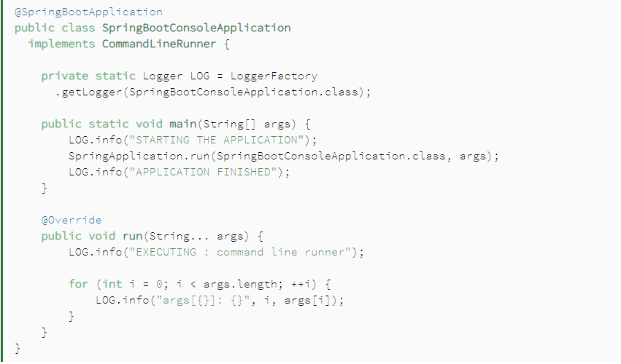
CommandLineRunner

Slide 18
Reading Properties
Spring Boot has many useful features including externalized configuration and easy access to properties defined in properties files.
Spring Boot supports reading from:
application.properties
application.yaml

Slide 19
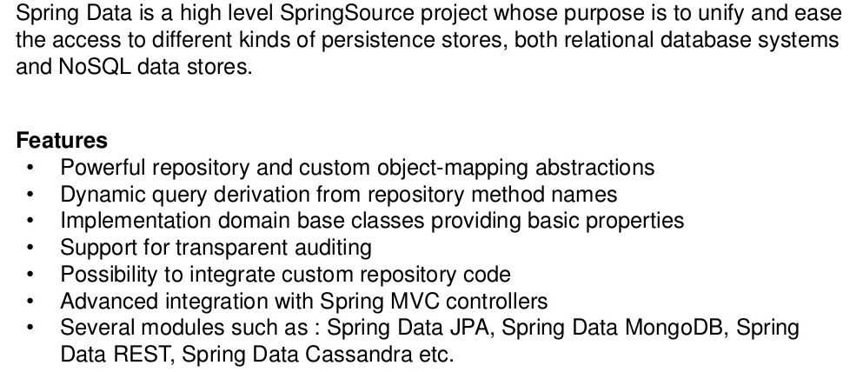
Spring Data JPA

Slide 20
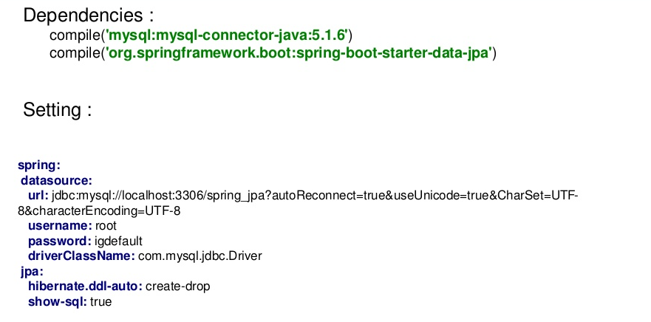
Configuration

Slide 21
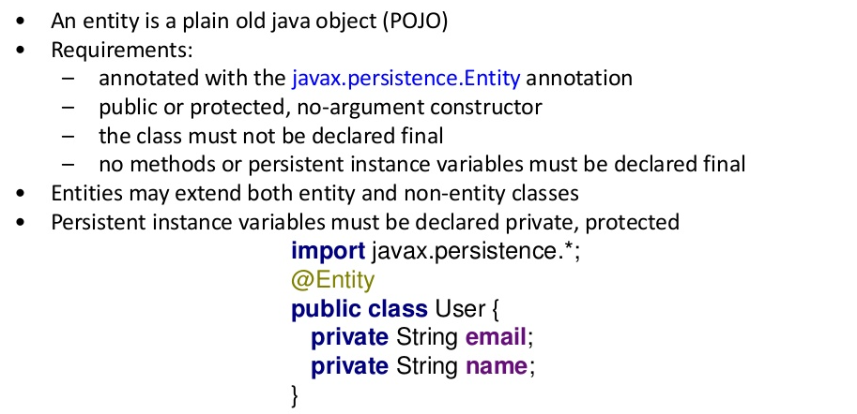
Domain/Entities

Slide 22
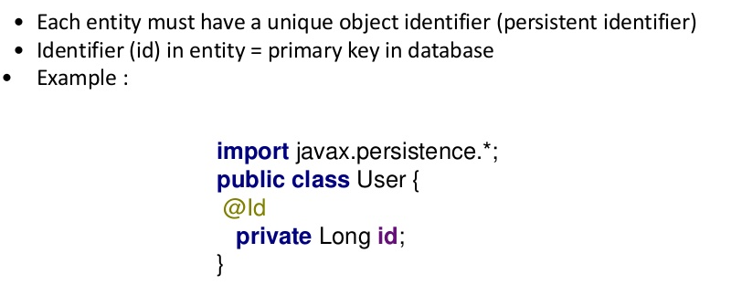
Persistence Identity

Slide 23
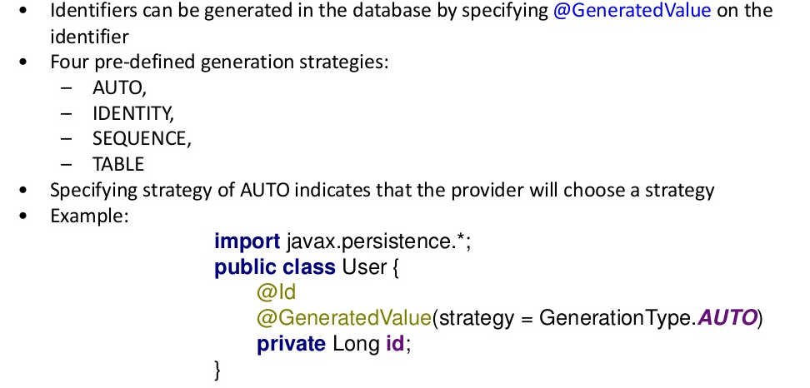
Identity Generator

Slide 24
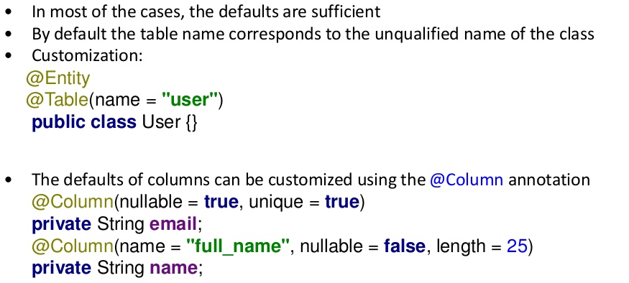
Customizing Entity Object

Slide 25
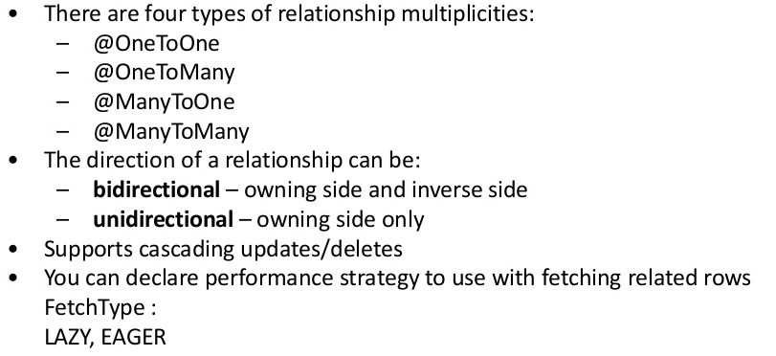
Entity Relationship

Slide 26
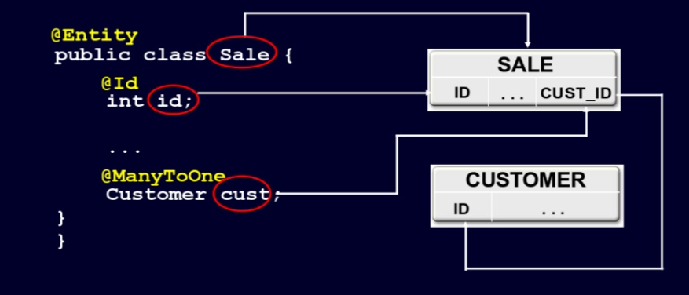
Many to One Relationship

Slide 27
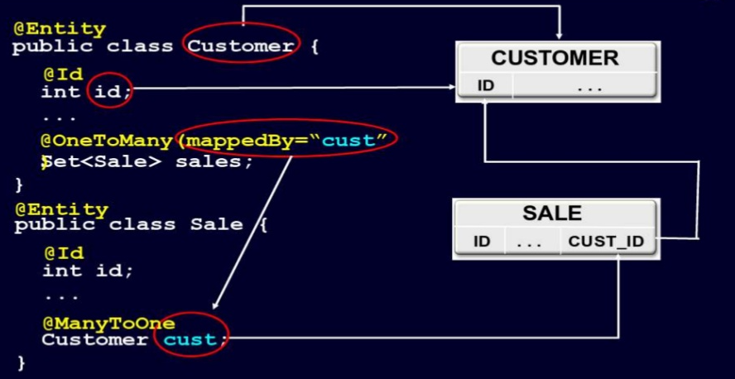
One To Many Relationship

Slide 28
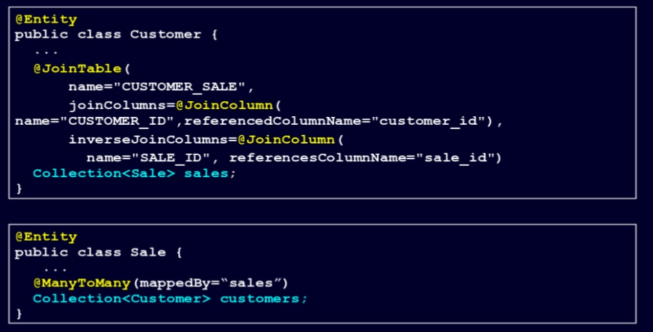
Many to Many Relationship

Slide 29
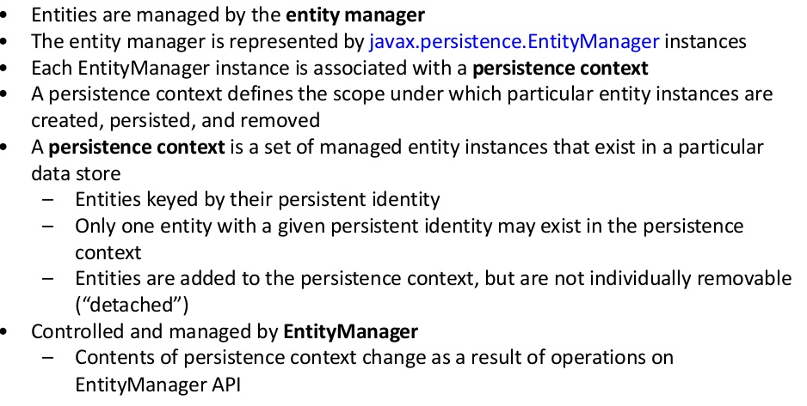
Managing Entities in JPA

Slide 30
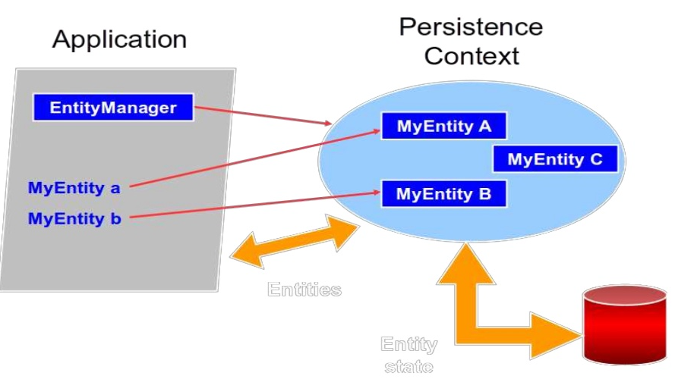
Persistence Context

Slide 31
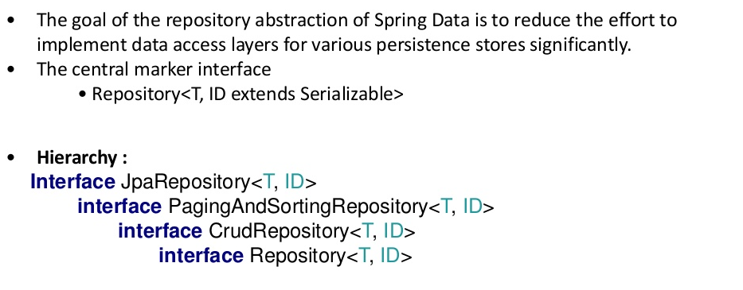
Repository Hierarchy

Slide 32
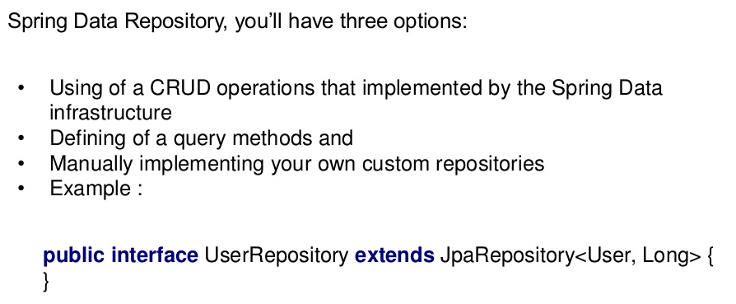
User Defined Repository

Slide 33
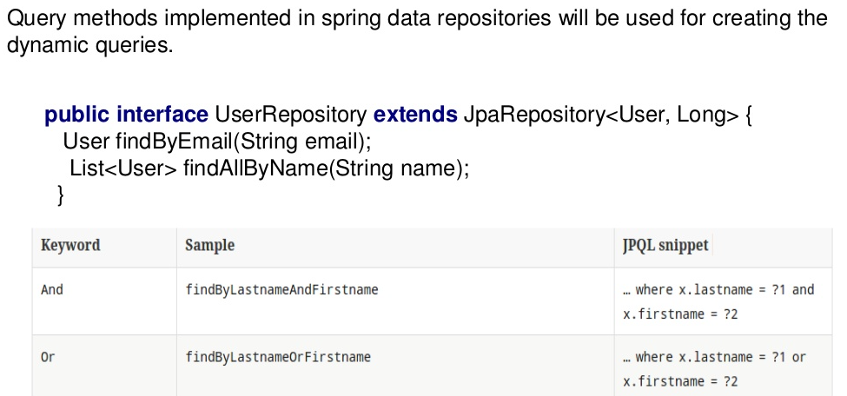
Defining Query Methods

Slide 34
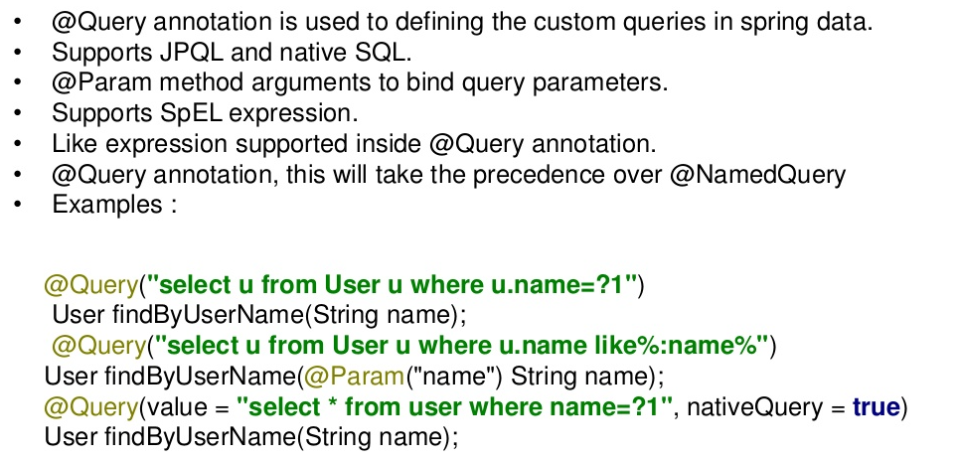
Custom Queries

Slide 35
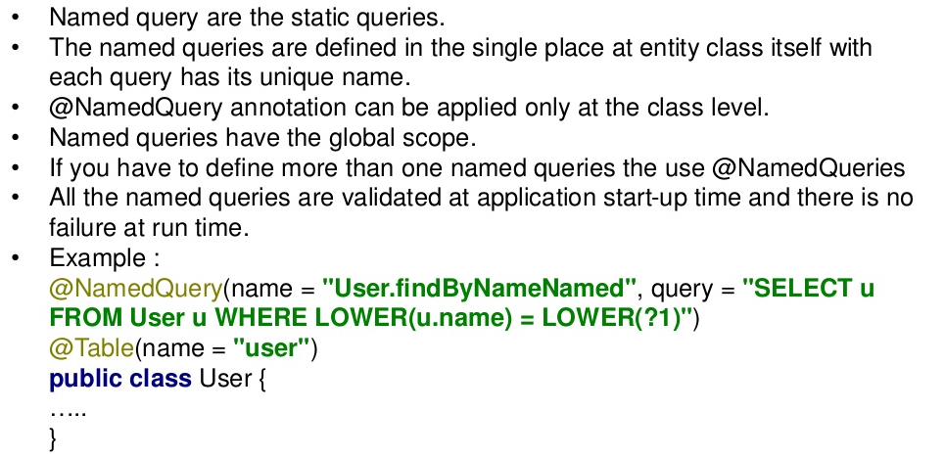
Named Queries

Slide 36
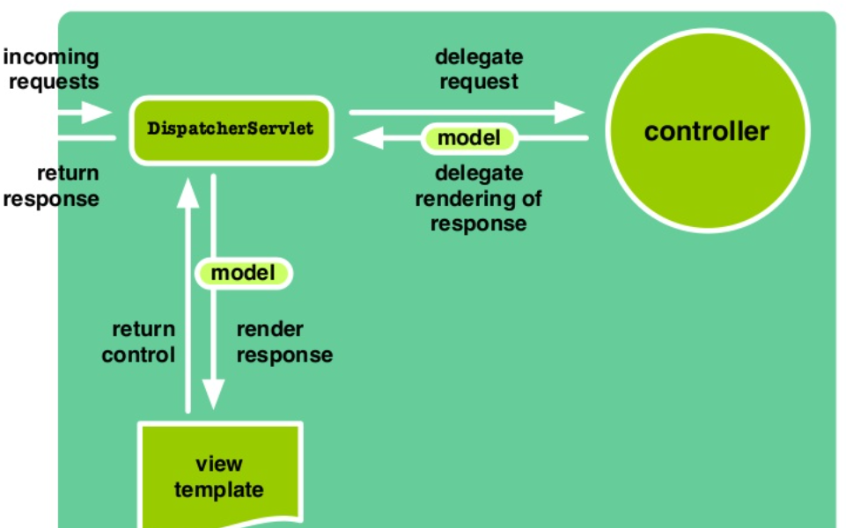
Spring MVC Architecture

Slide 37
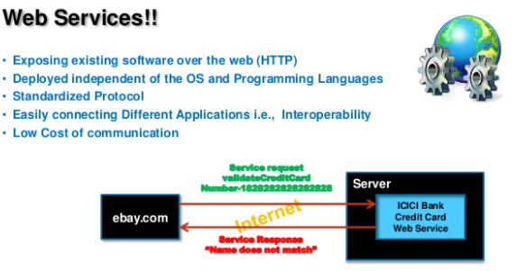
Web Services

Slide 38
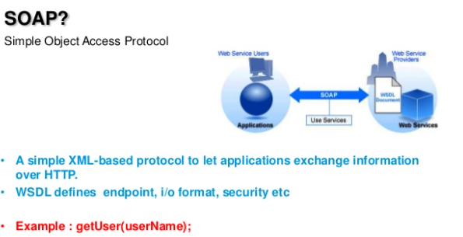
SOAP

Slide 39
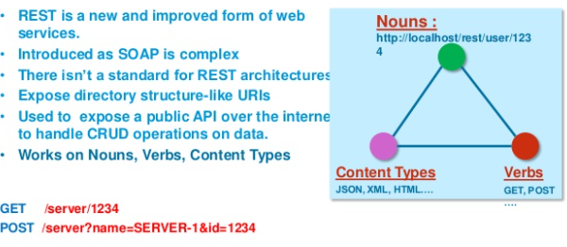
REST

Slide 40
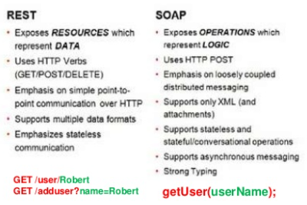
SOAP VS REST

Slide 41
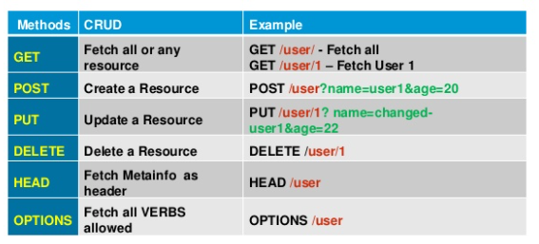
HTTP Methods – CRUD in REST

Slide 42
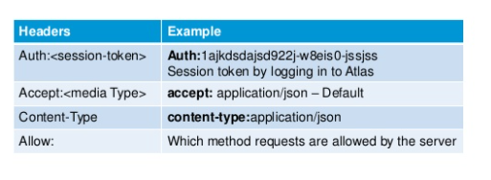
HTTP Headers

Slide 43
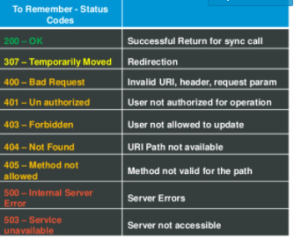
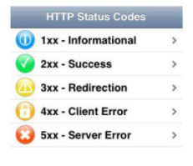
HTTP Status Codes

Slide 44
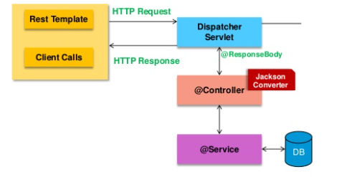
Rest Calls in Spring

Slide 45
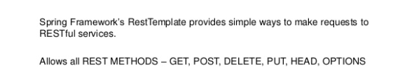
RestTemplate Class

Slide 46
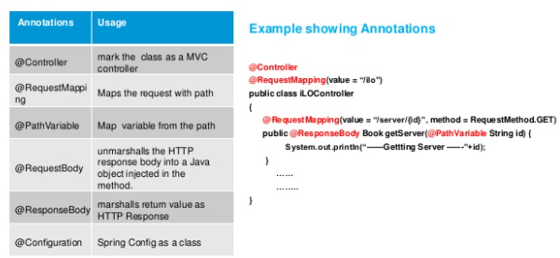
Annotations in REST

Slide 47

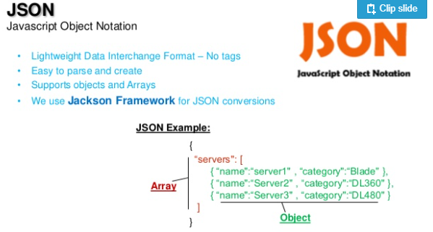
JSON Representation

Slide 48
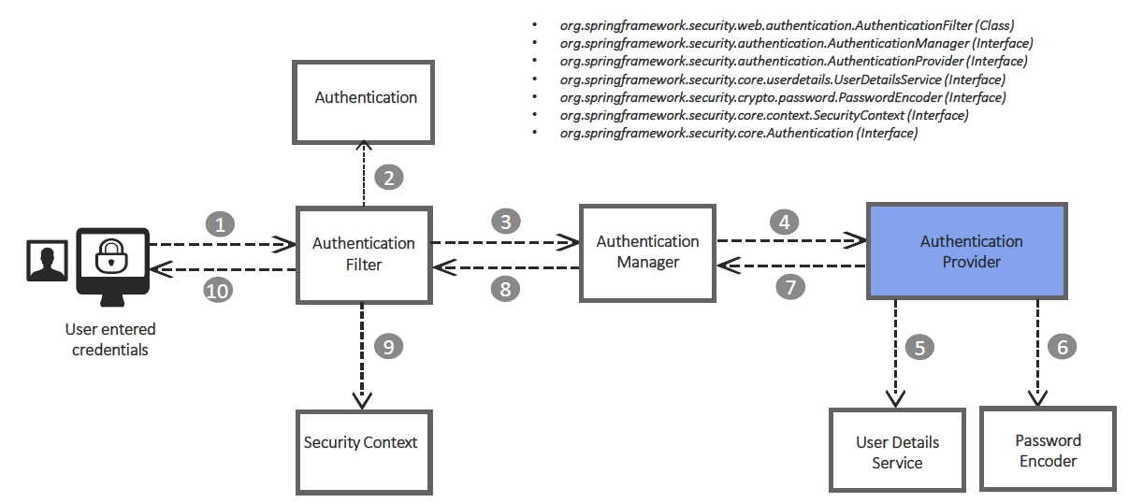
Spring Security - Architecture

Slide 49
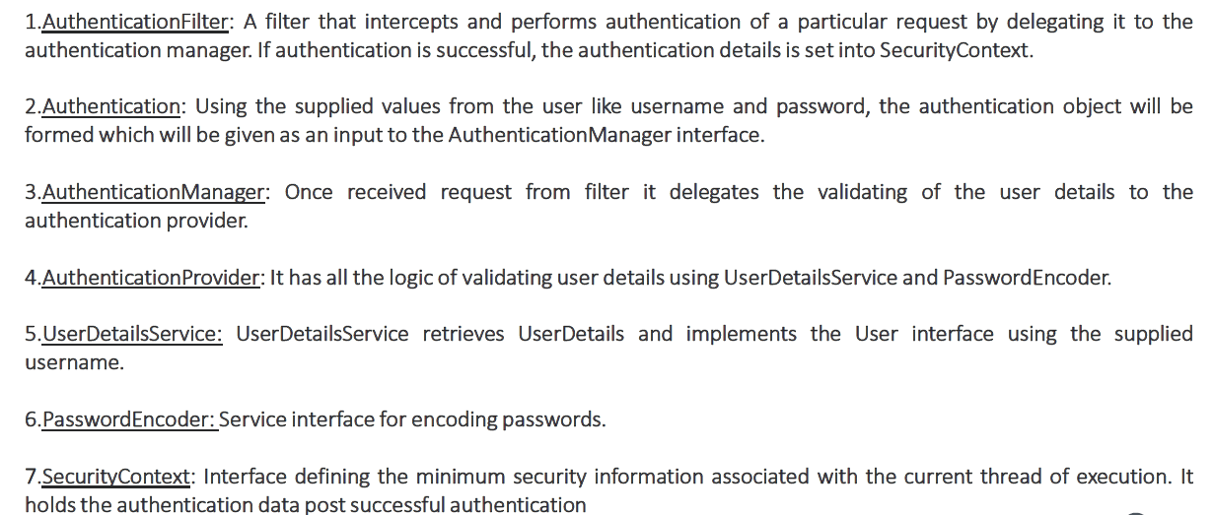
Spring Security - Architecture

Slide 50
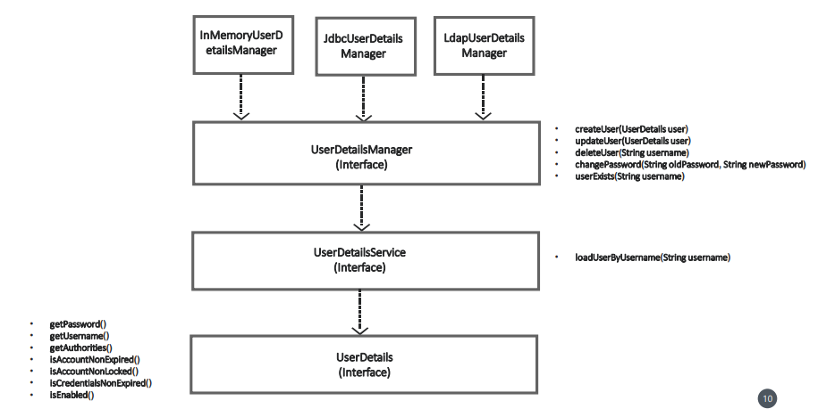
User Management

Slide 51
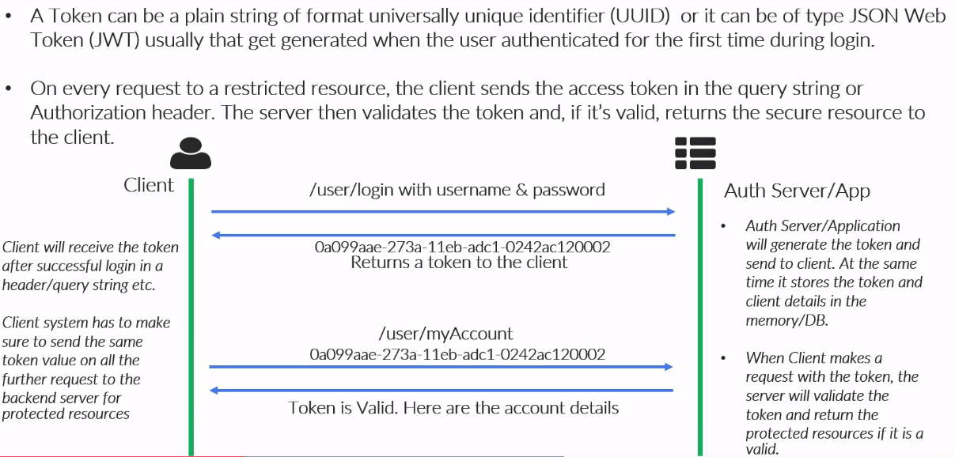
Token Based Security

Slide 52
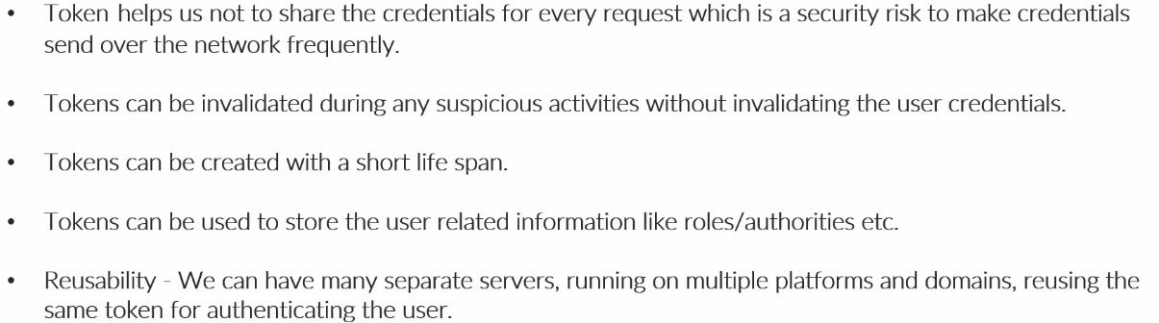
Advantages of Token Based Security

Slide 53
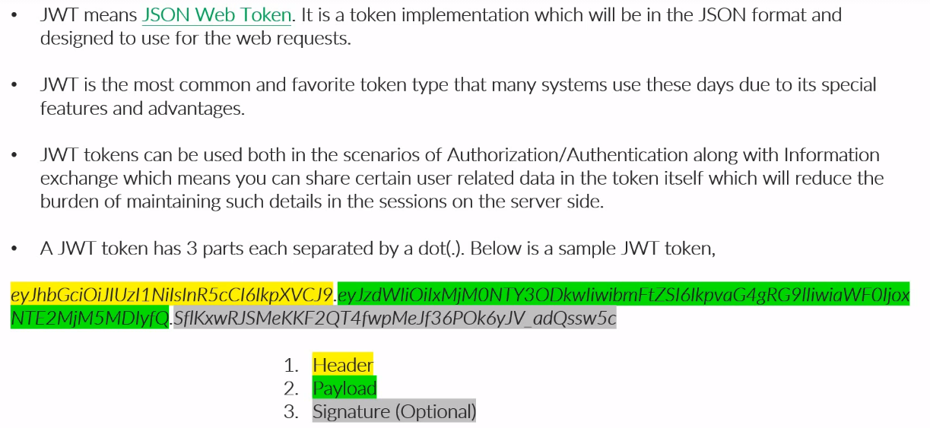
JWT Token

Slide 54
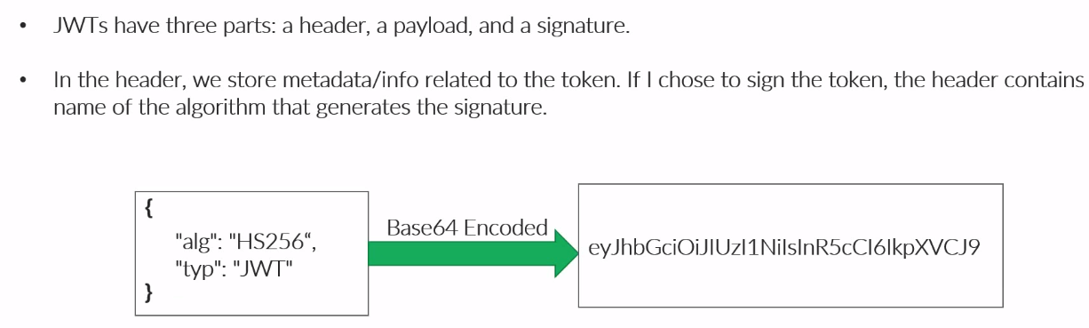
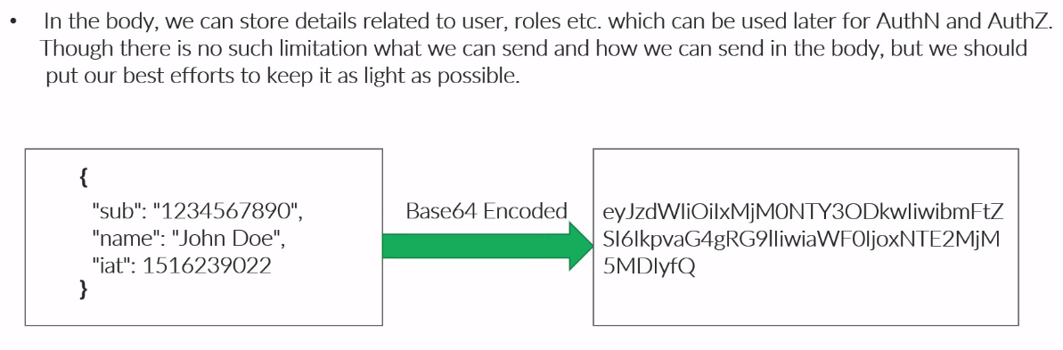
JWT Token

Slide 55
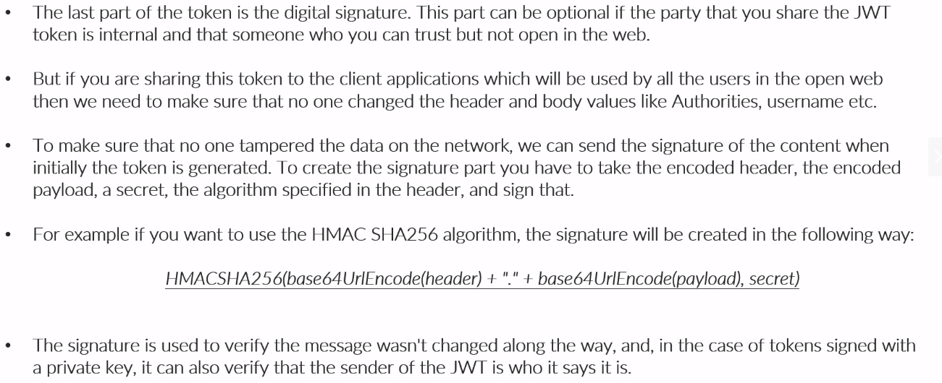
JWT Token

Slide 56
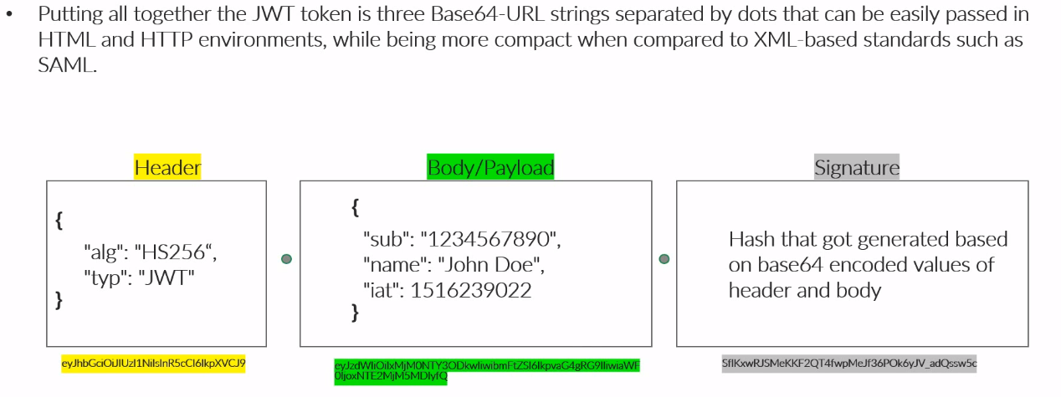
JWT Token

Slide 57
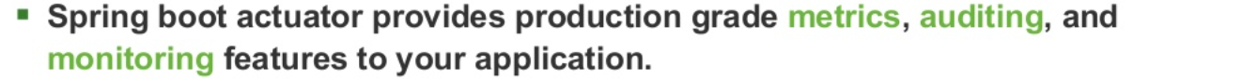

Monitoring Applications

Slide 58


Monitoring Applications

Slide 59

Enabling Actuator Endpoints

Slide 60

Actuator Features

Slide 61


Packaging Applications

Slide 62


Packaging Applications

